Slide 1
Video Games Sales Analysis
EDA

Slide 2
Table of Cotent
Introduction
Problem Description
Methodology
Result

Slide 3
Introduction

Slide 4
Who doesn't like video games?
Video games have become a favorite pastime for most of us. Video games are a billion-dollar business and have been for many years. Now imagine being able to analyze the sales trends for the popular Nintendo games and many more such platforms. How cool would it be!

Slide 5
Problem Description

Slide 6
Every year globally, people spend huge amounts of money and time playing video games. Most people who engage in video game play to do so voluntarily, because it is fun, and they enjoy it. This makes it an intrinsically motivating activity. As a video game development company, we intend to develop a new video game based on the highest sales and genre globally that have high meta score.
Problem Description

Slide 7
Methodology

Slide 8
Methodology
Problem understanding
Data Cleaning
Questions & insight
Step 1
Step 3
Step 5
Step 2
Step 4
Load data &validation
Data Exploration
Step 6
Result

Slide 9
Understanding the
Dataset
Rank
The overall rank of the game
Name
The name of the game
Year
The year in which the game was released.
User REview
The review of game by user
Platform
The platform on which the game was released
Genre
The genre of the game
Publisher
The publisher of the game
Metascore
The score from 1 to 100 by the review aggregator Metacritic.
Release Date
The date o game released
NA Sales ,JP Sales , EU Sales , Other Sales, Global Sales.
Sales made by a particular game in North America, Europe, Japan, Other regions and Globally (in millions).

Slide 10
Pre-processing the dataset
To get started, we need to import some useful libraries that will help us import the dataset into our python environment, manipulate and analyze the same and later help us to visualize it.
Missing values & outliers was observed across the dataset, so a good approach it to either remove it or correct it .
zero
nan
?
Null
###

Slide 11
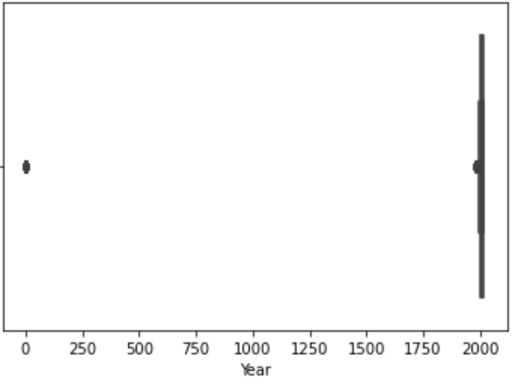
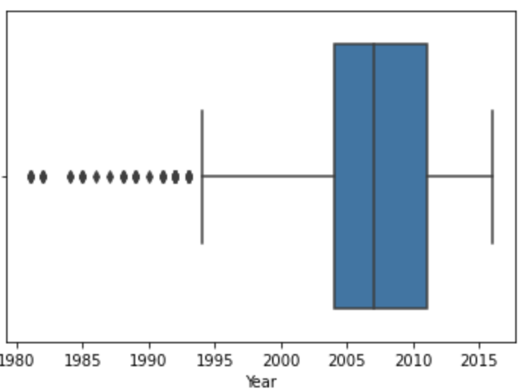
Use the interquartile range (IQR) to decide on what you consider to be an outlier
Before Transformation
After Transformation

Slide 12
Data Visualization

Slide 13
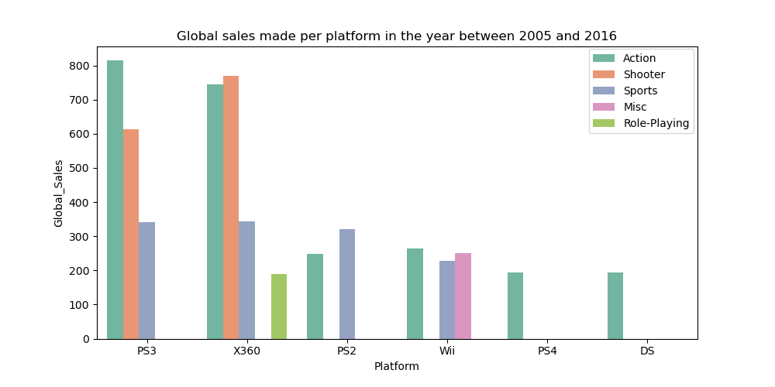
Global sales top 5 platform( 2005-2016)

Slide 14
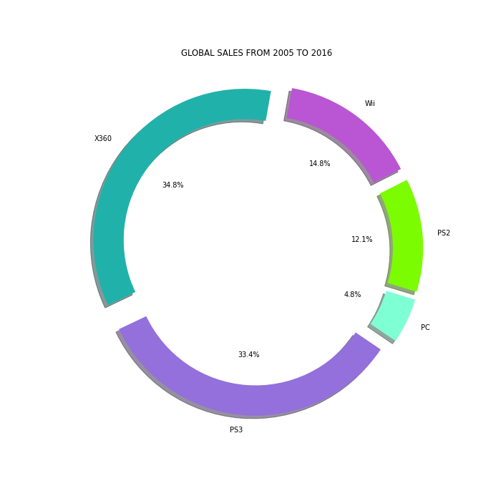
Results in global sales ( 2005-2016)
The pie char represent the global sales of top 5 platform from 2005 - 2016

Slide 15
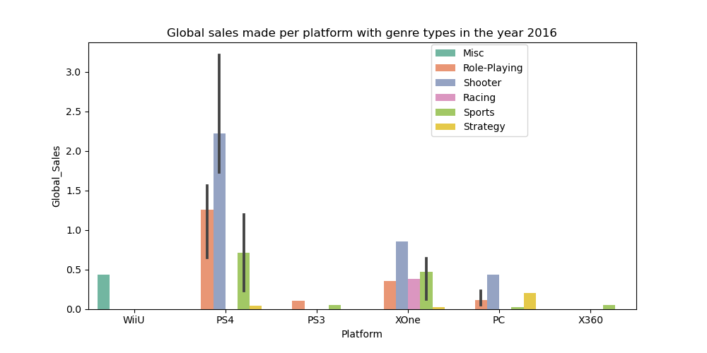
Global sales top 5 platform (2016)

Slide 16
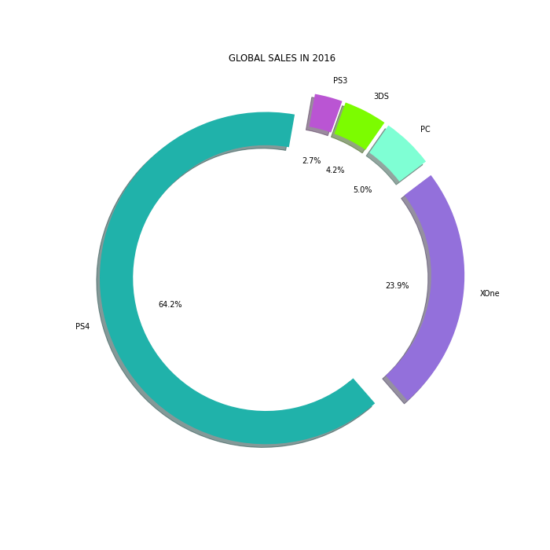
Results in global sales ( 2016)
The pie char represent the global sales of top 5 platform in 2016

Slide 17
Conclusion
Based on the results of the data analysis on global sales we noticed as a video game development company the top 5 video game platforms PS3, X360, PS2, Wii and PS4.
Accordingly, we selected from the five platforms the development of the PS4 platform based on the results of the 2016 data analysis specifically in shooter genre.

Slide 18
Thanks
Do you have any questions?

